Slide 1
Object Detection

Slide 2
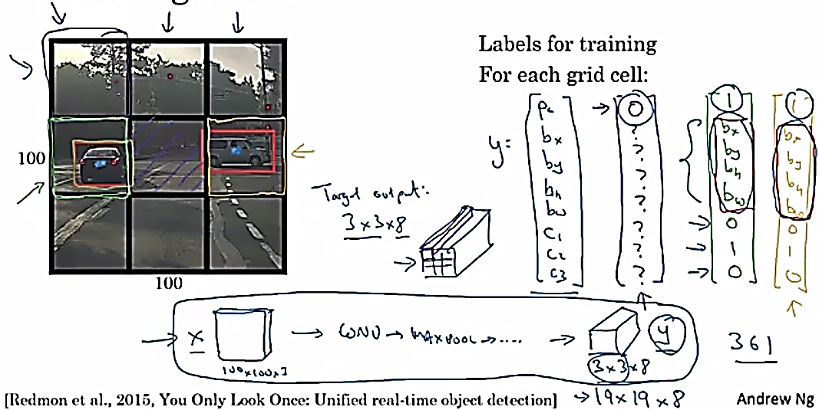
YOLO Algorithm

Slide 3
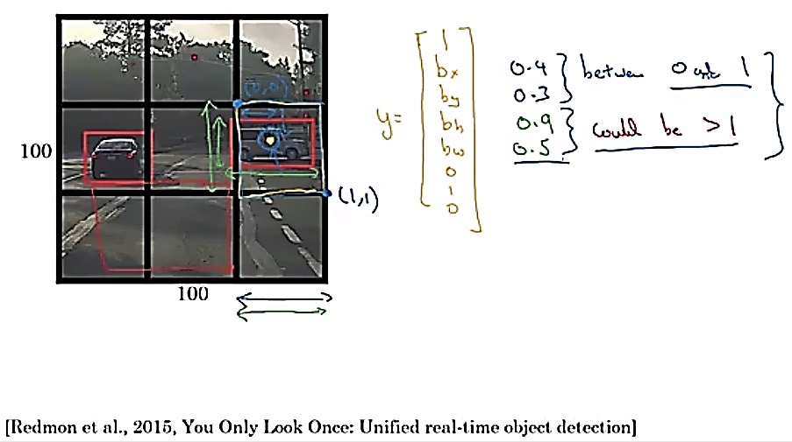
YOLO Algorithm
Specify the Bounding Boxes

Slide 4
Object Detection
Intersection over union

Slide 5
Evaluating object localization
“Correct” if IoU $≥$ 0.5
More generally, IoU is a measure of the overlap between two bounding boxes.

Slide 6
Object Detection
Non-max suppression

Slide 7
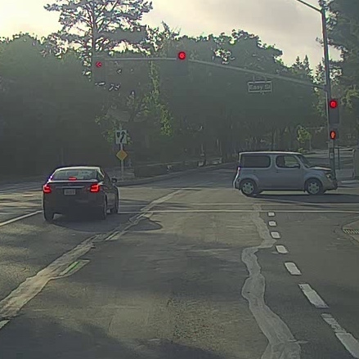
Non-max suppression example

Slide 8
Non-max suppression example
0.6
0.8
0.9
0.3
0.5

Slide 9
Non-max suppression example
0.6
0.8
0.9
0.7
0.7

Slide 10
Non-max suppression algorithm
$$\left[\begin{aligned}p_{c} \\ b_{x} \\ b_{y} \\ b_{h} \\ b_{w}\end{aligned}\right]$$
Each output prediction is:
Discard all boxes with $p_{c}≤0.6$
While there are any remaining boxes:
Pick the box with the largest $p_{c}$
Output that as a prediction.
19$×19$
Discard any remaining box with
IoU $≥0.5$with the box output
in the previous step

Slide 11
Object Detection
Anchor boxes

Slide 12
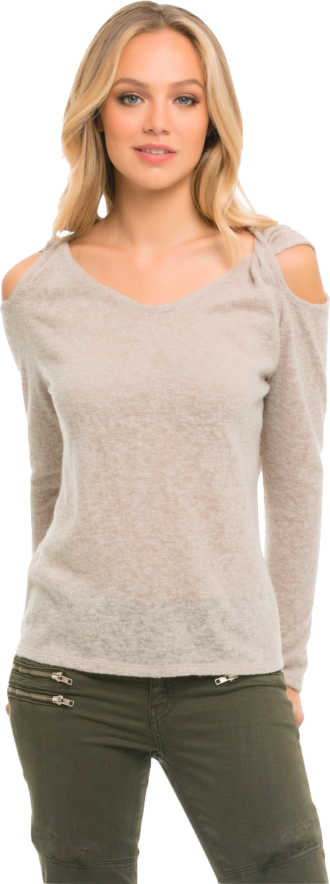
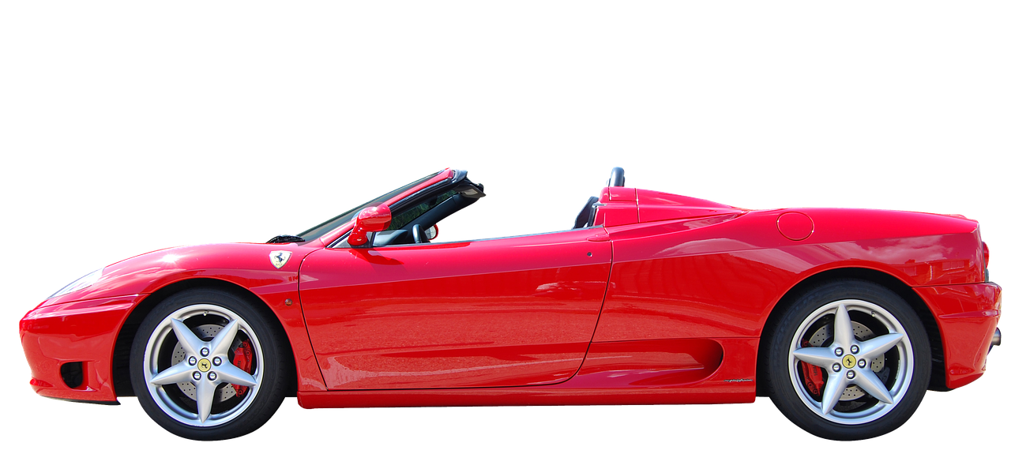
Overlapping objects:
Anchor box 1:
Anchor box 2:
$$\left[\begin{aligned}p_{c} \\ b_{x} \\ b_{y} \\ b_{h} \\ b_{w} \\ c_{1} \\ c_{2} \\ c_{3}\end{aligned}\right]$$
y =
[Redmon et al., 2015, You Only Look Once: Unified real-time object detection]

Slide 13
Anchor box algorithm
Previously:
With two anchor boxes:
Each object in training image is assigned to grid cell that contains that object’s midpoint.
Each object in training image is assigned to grid cell that contains object’s midpoint and anchor box for the grid cell with highest IoU.

Slide 14
Anchor box example
y = $\left[\begin{aligned}p_{c} \\ b_{x} \\ b_{y} \\ b_{h} \\ b_{w} \\ c_{1} \\ c_{2} \\ c_{3} \\ p_{c} \\ b_{x} \\ b_{y} \\ b_{h} \\ b_{w} \\ c_{1} \\ c_{2} \\ c_{3}\end{aligned}\right]$
Anchor box 1:
Anchor box 2:

Slide 15
Object Detection
Putting it together:
YOLO algorithm

Slide 16
Training
1 - pedestrian
2 - car
$\left[\begin{aligned}p_{c} \\ b_{x} \\ b_{y} \\ b_{h} \\ b_{w} \\ c_{1} \\ c_{2} \\ c_{3} \\ p_{c} \\ b_{x} \\ b_{y} \\ b_{h} \\ b_{w} \\ c_{1} \\ c_{2} \\ c_{3}\end{aligned}\right]$
$$\left[\begin{aligned}0 \\ ? \\ ? \\ ? \\ ? \\ ? \\ ? \\ ? \\ 0 \\ ? \\ ? \\ ? \\ ? \\ ? \\ ? \\ ?\end{aligned}\right]$$
$$\left[\begin{aligned}0 \\ ? \\ ? \\ ? \\ ? \\ ? \\ ? \\ ? \\ 1 \\ b_{x} \\ b_{y} \\ b_{h} \\ b_{w} \\ 0 \\ 1 \\ 0\end{aligned}\right]$$
3 - motorcycle
y
=
y is $3×3×2×8$
[Redmon et al., 2015, You Only Look Once: Unified real-time object detection]

Slide 17
Making predictions
$\left[\begin{aligned}p_{c} \\ b_{x} \\ b_{y} \\ b_{h} \\ b_{w} \\ c_{1} \\ c_{2} \\ c_{3} \\ p_{c} \\ b_{x} \\ b_{y} \\ b_{h} \\ b_{w} \\ c_{1} \\ c_{2} \\ c_{3}\end{aligned}\right]$
$$⋯$$
$y$ =
$$3×3×2×8$$

Slide 18
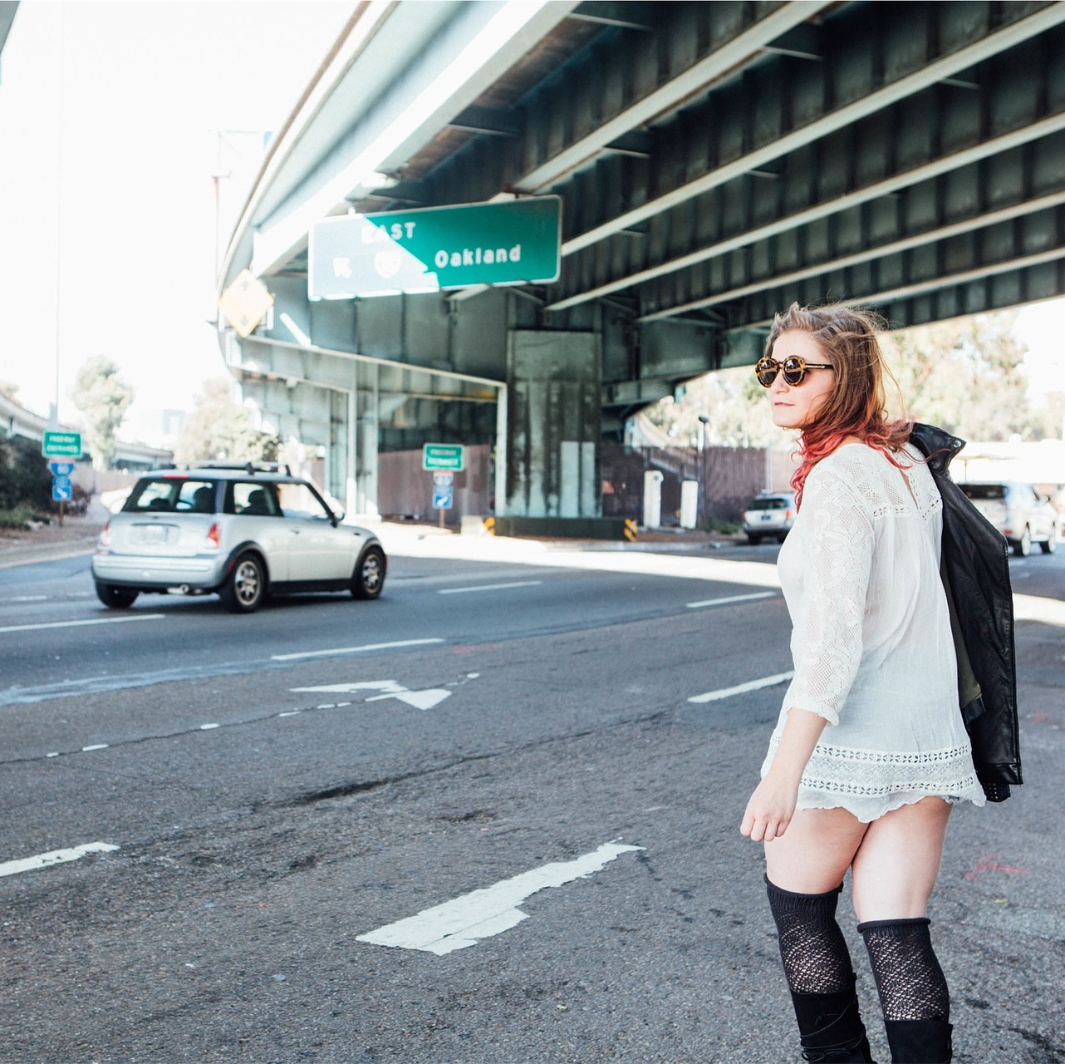
Outputting the non-max supressed outputs
For each grid cell, get 2 predicted bounding boxes.
Get rid of low probability predictions.
For each class (pedestrian, car, motorcycle) use non-max suppression to generate final predictions.

Slide 19
References
https://github.com/rafaelpadilla/Object-Detection-Metrics
https://medium.com/@timothycarlen/understanding-the-map-evaluation-metric-for-object-detection-a07fe6962cf3
Andrew Ng’s slide on object detections

Slide 20
Disclaimer
These slides are not original and have been prepared from various sources for teaching purpose.

